Slide 1
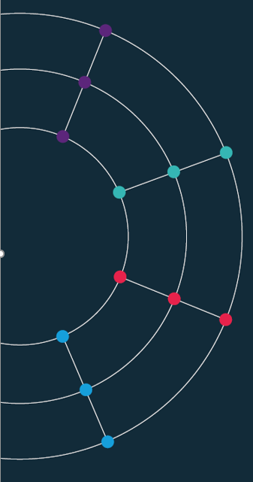
Session 5. Data scraping
[60 min]

Slide 2
Session 5. Data scraping
Scraping the HTML source
[60 min]
[30 min]

Slide 3
Scraping.
Not everyone likes it. But it’s (mostly) legal.
Scraping the HTML source. Easy. Automated.
Scraping static HTML pages.
A bit more difficult. Can be automated.
CAPTCHA. Impersonating a human user. Zombie browser.
Scraping HTML pages generated on-the-fly with JavaScript.
Hard. Only zombie browser works, and only in some cases.
hiQ labs vs. LinkedIn, 2019, US Court of Appeals for the Ninth Circuit, 17-16783
LinkedIn vs. hiQ labs, 2021, US Supreme Court, 19-1116
Notes:
https://jaxenter.com/data-scraping-cases-165385.html
https://www.bloomberglaw.com/public/desktop/document/HIQ_Labs_Inc_v_LinkedIn_Corp_No_1716783_2019_BL_336537_9th_Cir_Se?1636358098
https://www.bloomberglaw.com/public/desktop/document/LinkedInCorporationPetitionervshiQLabsIncDocketNo191116USMar12202?1624546490
https://news.bloomberglaw.com/us-law-week/supreme-court-scraps-linkedin-data-scraping-decision
BeautifulSoup
Selenium

Slide 4
Data wrangling directly in Vega-Lite.
Data sorting in Vega-lite.
https://vega.github.io/vega-lite/docs/sort.html
Layers.
https://vega.github.io/vega-lite/docs/layer.html
Transforms.
https://vega.github.io/vega-lite/docs/transform.html
Expression.
https://vega.github.io/vega/docs/expressions/
Nested data returned by an API. Double/multiple nesting – python only.

